Slide 1

Twitter Sentiment Analysis​

Slide 2
TABLE OF CONTENT
1
3
2
4
Queries and Learning Pipeline
Results
Related Work
5
Runtime performance using different number of computing nodes
6
Introduction Problem description
Data Profiling

Slide 3
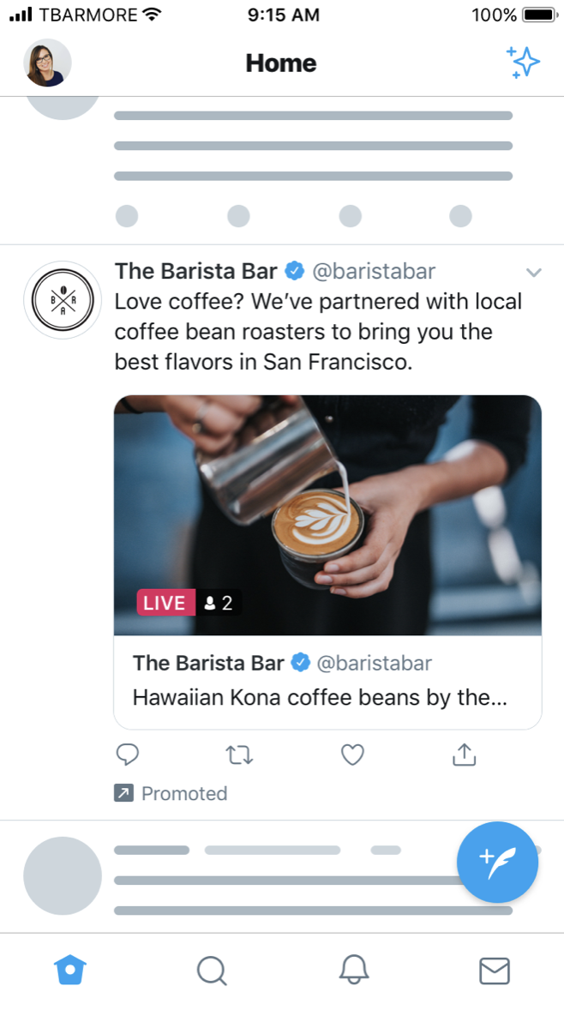
1. Twitter
Twitter is an online social media owned and operated by American company X Corp.
Twitter was created in 2006 and in October 2022 it was acquired by Elon Musk.
Every second, on average, around 6,000 tweets are tweeted on Twitter, corresponding to over 350,000 tweets sent per minute, 500 million tweets per day and around 200 billion tweets per year.

Slide 4
1. Sentiment Analysis
SA
GOAL
OPPORTUNITIES
CHALLENGES
Sentiment Analysis (SA) also called Opinion Mining, is currently one of the most studied research fields.
It aims to analyze people’s sentiments, opinions, attitudes, emotions, etc., towards elements such as topics, products, individuals, organizations, and services.
Sentiment Analysis offers many opportunities to develop new applications, especially due to the huge growth of available information in sources such as blogs and social networks.
One of the challenges is definition of elements involved in this area. Thus, it is necessary to define clearly concepts such as opinion, subjectivity or emotion, however, this task is not really easy.

Slide 5
Problem definition
The goal of this project is to use Big Data combined with Google Cloud and Machine Learning Techniques to perform Twitter Sentiment Analysis.
Sentiment analysis is framed in this project as a supervised learning task, where the aim is to classify the sentiment or emotion expressed in a given text.
The algorithm learns from a labeled dataset where each text is associated with a sentiment label (Positive and Negative).

Slide 6
2. Related Work
Article 1
Article 2
Article 3
Sentiment analysis: A review and comparative analysis of web services.
Machine learning and deep learning for sentiment analysis across languages: A survey.
Twitter Sentiment Classification using Distant Supervision.
The main idea of the article is to provide a comprehensive review and comparative analysis of various web services available for sentiment analysis. It analyze the accuracy and reliability of sentiment analysis results provided by different services, as well as their ease of use, speed, cost, available features, API documentation, and user reviews and other relevant aspects.
The article aims to address the challenges of sentiment analysis in multilingual settings. The authors discuss the various approaches and algorithms used, including traditional machine learning methods like Naive Bayes, Support Vector Machines (SVM), and Random Forests, as well as deep learning models such as Convolutional Neural Networks (CNNs), Recurrent Neural Networks (RNNs), and Transformer-based architectures like BERT.
The authors address the challenge of sentiment analysis on Twitter. Traditional supervised learning methods require manually labeled data, which can be time-consuming and costly to obtain for large-scale datasets like Twitter. To overcome this challenge, the authors propose the concept of distant supervision, where they leverage the inherent structure of Twitter to automatically label training data. They use emoticons or hashtags associated with positive or negative sentiments as noisy labels for sentiment classification.

Slide 7







3 Data Profiling
Dataset: Sentiment140
The @user that tweeted
+ 1.5 M
Labeled Tweets
The date of the tweet
The text of the tweet
The polarity of the tweet
(Negative or Positive)
The original label was made under the following approach :
Tweets with positive emoticons, like :) were positive. Tweets with negative emoticons, like :( were negative.

Slide 8
3.1 Data Cleaning
‘@’mention
URL links
HTML decoding
This function takes a text input and applies HTML parsing using BeautifulSoup. The BeautifulSoup constructor is called with the input to parse the HTML content and extract the plain text. The decoded text is then stored in a new column named "text_parsed".
The purpose of this code is to remove mentions (user mentions starting with '@') from the "text" column. It takes a text input and uses the re.sub() function to substitute mentions with an empty string.
The purpose of this code is to remove URL links from the "text" column. It also uses regular expressions (re.sub()) to find and substitute the URLs with an empty string. This step to exclude URLs which are not relevant to sentiment classification is very importante as it can introduce noise in the analysis.

Slide 9

3.1 Data Cleaning
UTF-8 BOM (Byte Order Mark)
Hashtag / numbers
This steps encodes the text_value as UTF-8 with a Byte Order Mark (BOM) using the "utf-8-sig" encoding. This step is useful when dealing with text that contains special characters or different encodings. After, the re.sub() function replaces any characters that are not within the ASCII range with a question mark ('?')
By applying this step, any character in the 'text' column that is not a letter will be replaced with a space. This can is useful for cleaning up text data and removing characters such as numbers, hashtags, punctuation, and special symbols, leaving only the alphabetical content.

Slide 10
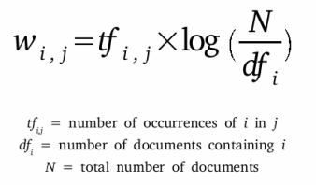
3.2 Data Preprocessing
Remove Stop Words
{‘ourselves’, ‘hers’, ‘between’, ‘yourself’, ‘but’, ‘again’, ‘there’, ‘about’, ‘once’, ‘during’, ‘out’, ‘very’, ‘having’, ‘with’, ‘they’, ‘own’, ‘an’, ‘be’, ‘some’, ‘for’, ‘do’, ‘its’, ‘yours’, ‘such’, ‘into’, ‘of’, ‘most’, ‘itself’, ‘other’, ‘off’, ‘is’, ‘s’, ‘am’, ‘or’, ‘who’, ‘as’, ‘from’, ‘him’, ‘each’, ‘the’, ‘themselves’, ‘until’, ‘below’, ‘are’, ‘we’, ‘these’, ‘your’, ‘his’, ‘through’, ‘don’, ‘nor’, ‘me’, ‘were’, ‘her’, ‘more’, ‘himself’, ‘this’, ‘down’, ‘should’, ‘our’, ‘their’, ‘while’, ‘above’, ‘both’, ‘up’, ‘to’, ‘ours’, ‘had’, ‘she’, ‘all’, ‘no’, ‘when’, ‘at’, ‘any’, ‘before’, ‘them’, ‘same’, ‘and’, ‘been’, ‘have’, ‘in’, ‘will’, ‘on’, ‘does’, ‘yourselves’, ‘then’, ‘that’, ‘because’, ‘what’, ‘over’, ‘why’, ‘so’, ‘can’, ‘did’, ‘not’, ‘now’, ‘under’, ‘he’, ‘you’, ‘herself’, ‘has’, ‘just’, ‘where’, ‘too’, ‘only’, ‘myself’, ‘which’, ‘those’, ‘i’, ‘after’, ‘few’, ‘whom’, ‘t’, ‘being’, ‘if’, ‘theirs’, ‘my’, ‘against’, ‘a’, ‘by’, ‘doing’, ‘it’, ‘how’, ‘further’, ‘was’, ‘here’, ‘than’}
Calculate TF-IDF
Term Frequency (TF) : Measures the number of times a word appears in a document
Inverse Document Frequency (IDF): Measures the rarity of a word across a collection of documents
TF-IDF = Term Frequency * Inverse Document Frequency

Slide 11
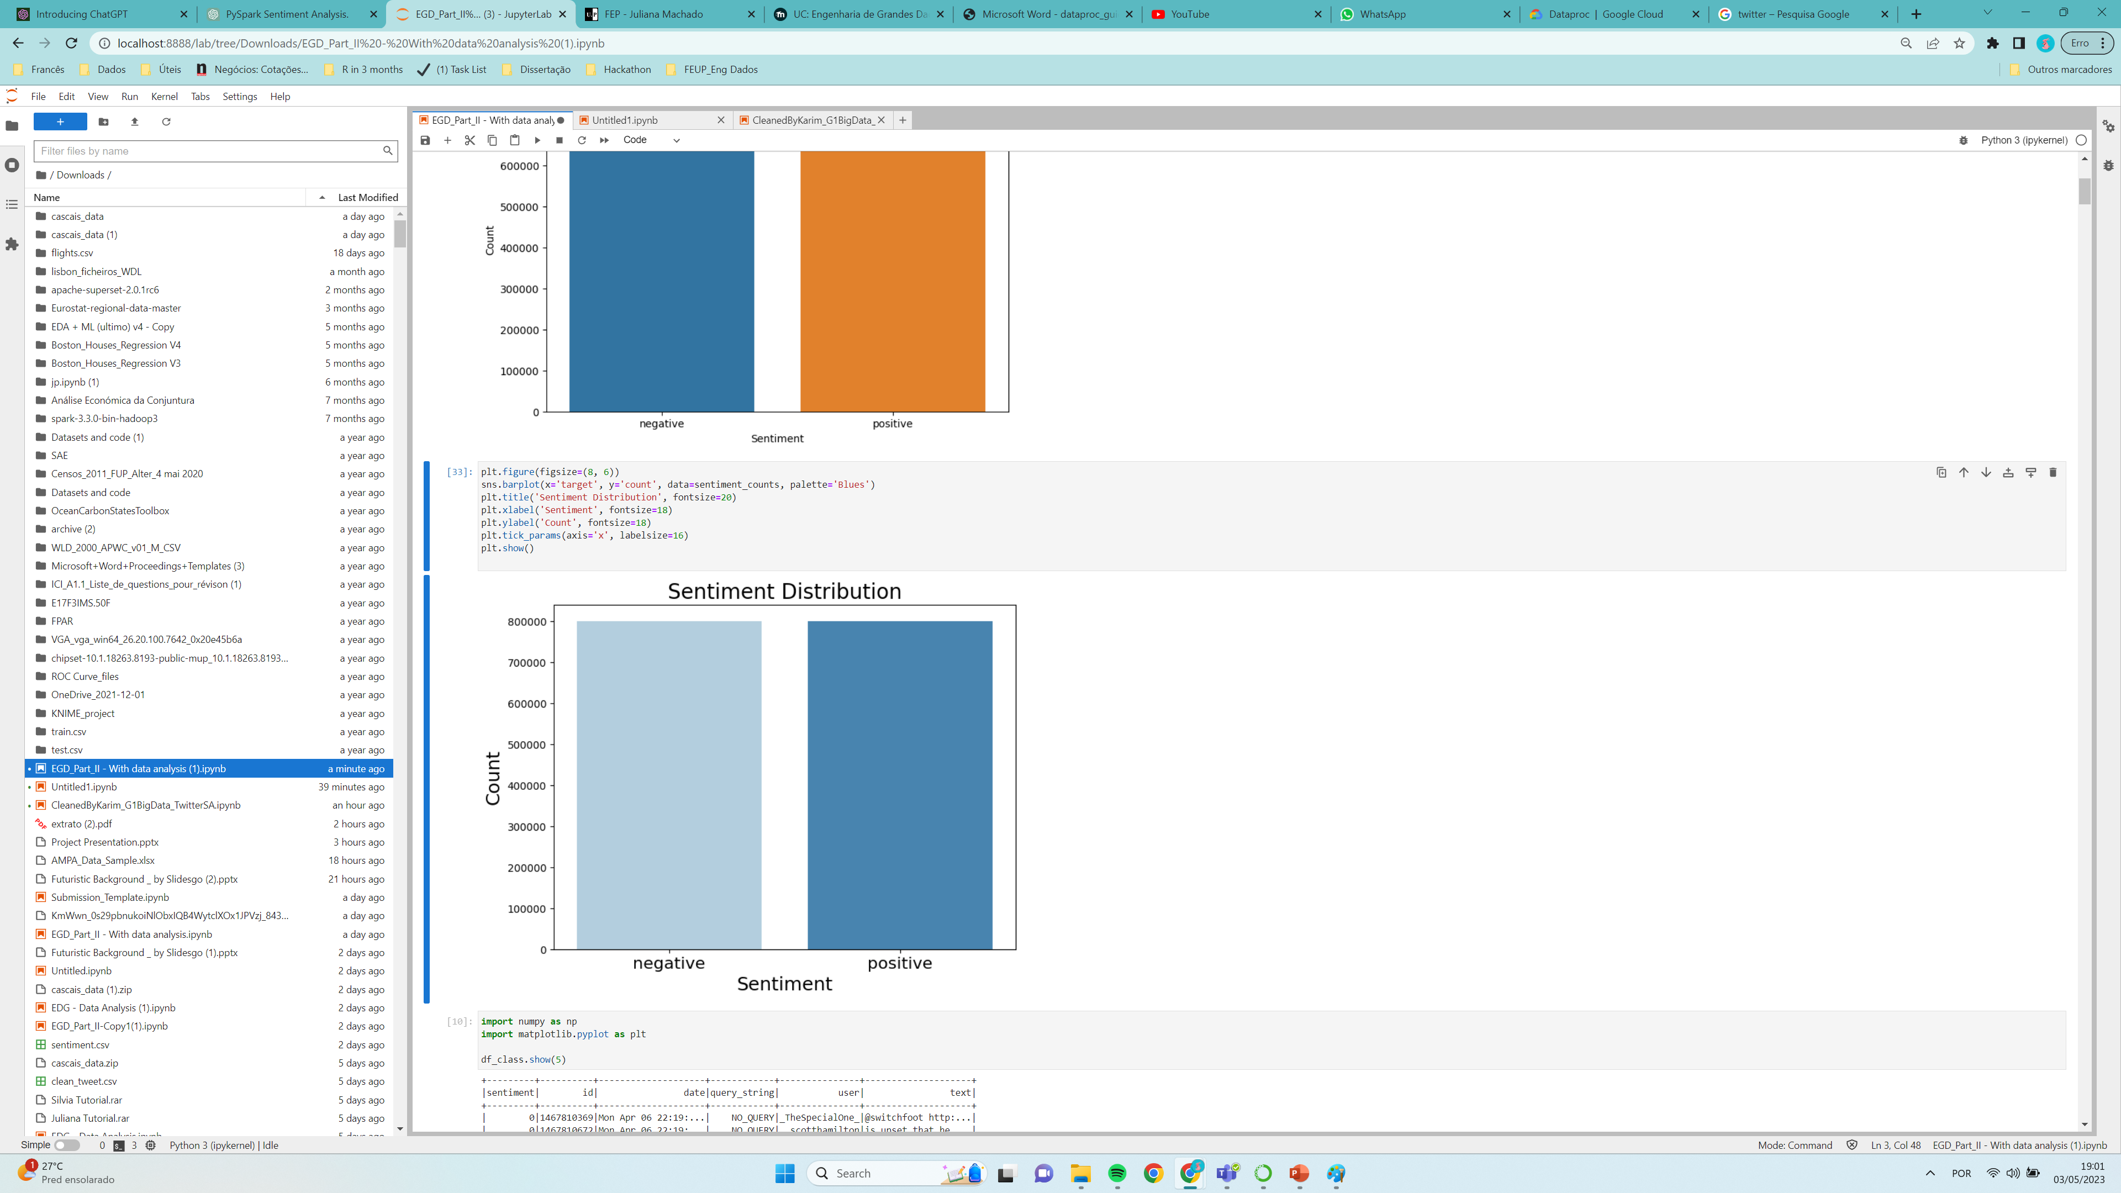
3.2 Data Visualization

Slide 12
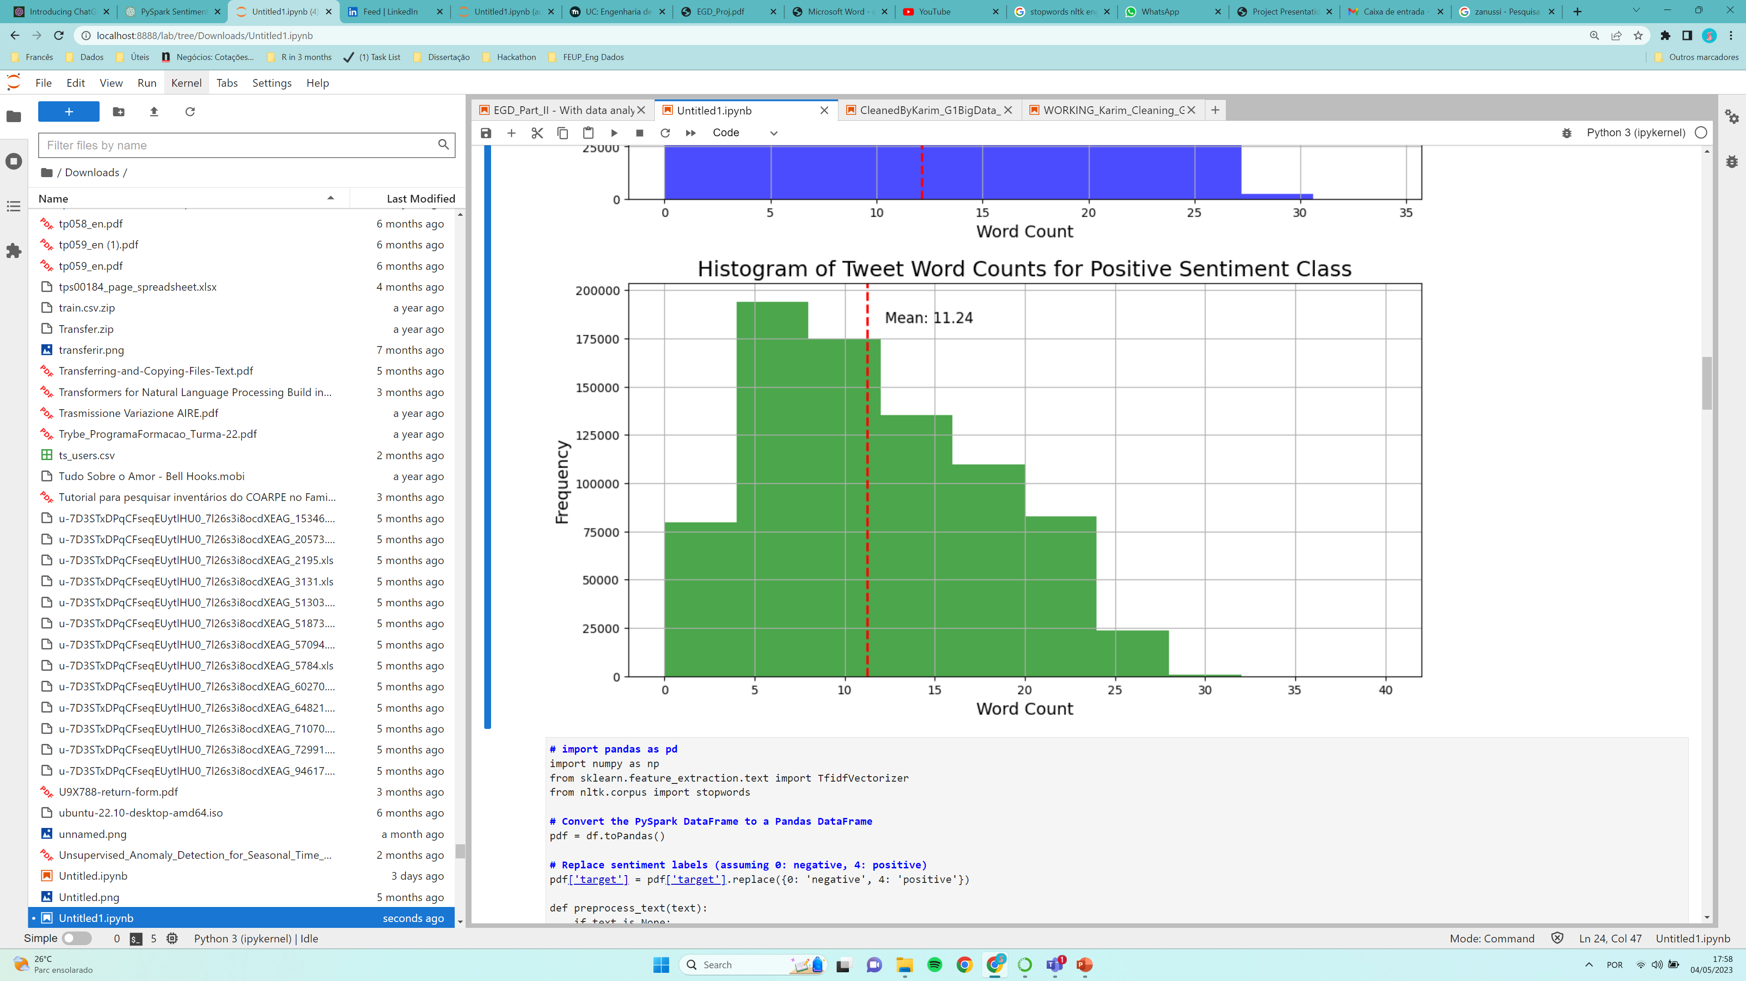
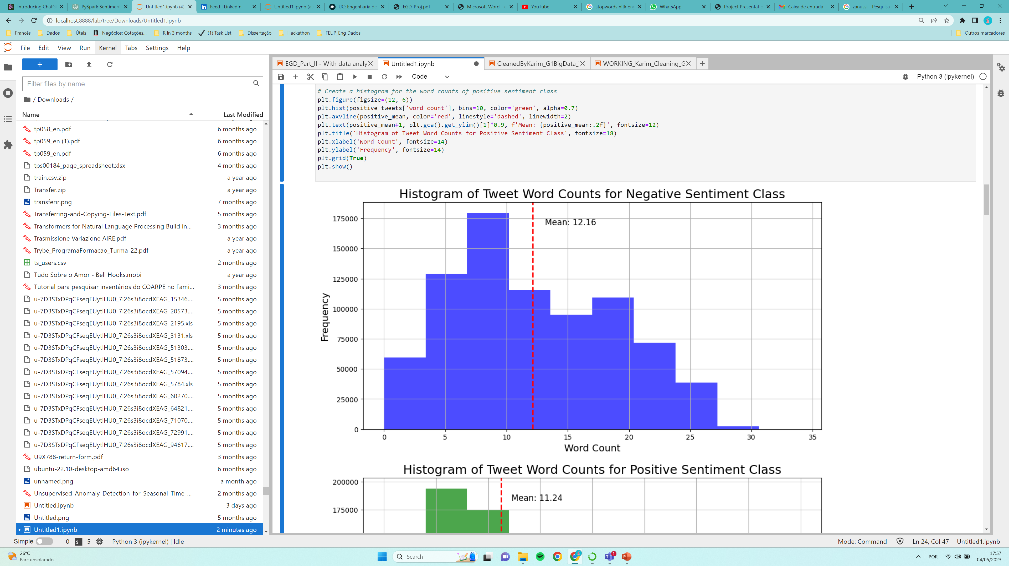
3.2 Data Visualization

Slide 13
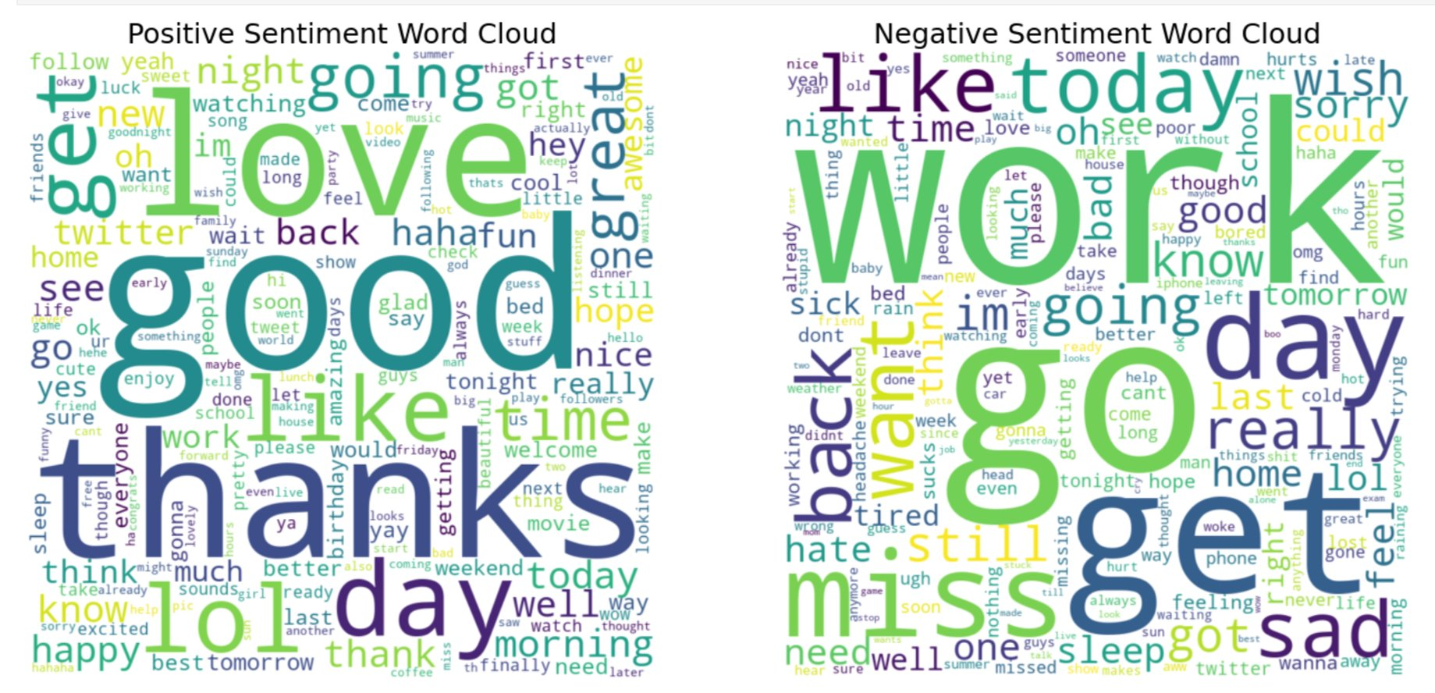
3.2 Word Cloud

Slide 14
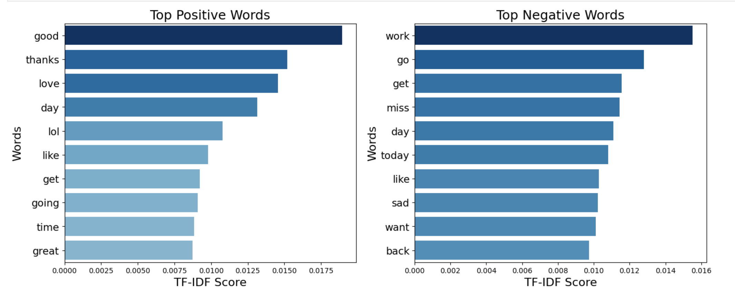
3.2 Top Words

Slide 15
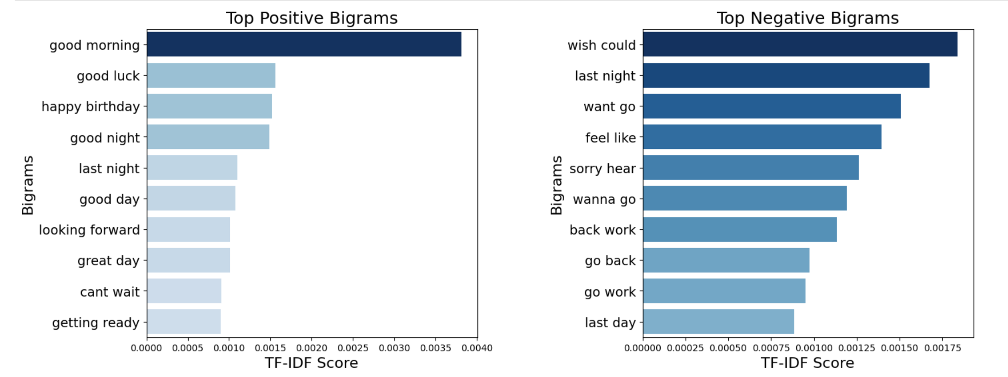
3.2 Top Bigrams

Slide 16
01
02
03
4. Modeling
Naive Bayes
Logistic Regression with Maximum Entropy
Random Forest
It is a supervised machine learning algorithm that is based on Bayes theorem. The key assumption of Naive Bayes is that the features (words or other attributes) are conditionally independent given the class label. It is particularly popular for text classification tasks, such as spam filtering, sentiment analysis, and document categorization.
Logistic Regression with Maximum Entropy, often referred to simply as Logistic Regression or MaxEnt, is a popular statistical model used for binary classification tasks. It is based on the concept of maximum entropy, which aims to find the model that makes the least assumptions about the data while still being consistent with the observed information.
This model is an ensemble learning algorithm that combines multiple decision trees to make a final prediction. It works by creating a set of decision trees, each trained on a random subset of the input data.
Notes:
02 – maxItr = 10, regparam = 0.01 03- 10 trees wit max depth 10

Slide 17
04
05
06
4. Modeling
GBoost
Support Vector Machine
HashingTF + IDF + Logistic Regression
Gradient Boosted Trees is also an ensemble learning algorithm that combines multiple weak models to make a final prediction. It works by creating a series of decision trees, each trained on the errors of the previous tree.
The basic idea of SVM is to map input data points into a higher-dimensional feature space where the data points from different classes can be separated by a hyperplane. SVM then finds the optimal hyperplane that maximizes the margin between the support vectors (data points closest to the hyperplane) of different classes.
TF-IDF with Logistic Regression is quite a strong combination, and showed robust performance, as high as Word2Vec + Convolutional Neural Network model. TF-IDF captures the importance of words in sentiment analysis, while Logistic Regression effectively learns the relationships between these weighted features and sentiment labels.
Notes:
The basic idea of SVM is to map input data points into a higher-dimensional feature space where the data points from different classes can be separated by a hyperplane. SVM then finds the optimal hyperplane that maximizes the margin between the support vectors (data points closest to the hyperplane) of different classes. The support vectors are the critical data points that determine the position and orientation of the hyperplane.
same as 02
In the context of natural language processing, HashingTF stands for "Hashing Term Frequency" and IDF stands for "Inverse Document Frequency".
HashingTF is a feature extraction technique used to convert a collection of text documents into a set of numerical feature vectors. It maps each term in the document to a unique integer index, and then counts the frequency of each term in the document. It then converts this count vector to a sparse vector where each entry represents the count of a term at its index position.
IDF is a technique used to weight the importance of each term in the document. It calculates a weight for each term based on how frequently it appears across all documents. Terms that are more common across all documents are given a lower weight, while terms that are less common are given a higher weight. This helps to highlight important terms that are unique to specific documents.

Slide 18
07
08
4. Modeling
CountVectorizer + IDF + Logistic Regression
N-gram
The purpose of this code is to build a pipeline for sentiment analysis using n-grams, word occurrence counts, TF-IDF, and Logistic Regression. N-grams play a crucial role in sentiment analysis by capturing contextual information, sentiment intensity, negations, modifiers, idiomatic expressions, sarcasm, and handling out-of-vocabulary words.
This is another powerful combination for sentiment analysis. CountVectorizer captures the local word frequencies, IDF assigns weights to words based on their global rarity, and Logistic Regression models the relationship between the weighted features and sentiment labels. This combination can effectively handle sentiment analysis tasks by capturing important word features and making accurate predictions.
Notes:
CountVectorizer is a technique used in Natural Language Processing for converting a collection of text documents to a matrix of token counts. Each row of the matrix represents a document, while each column represents a specific token (word) in the entire document collection. The value in each cell is the count of the corresponding token in the corresponding document. The resulting matrix is known as a term-document matrix, where each term is a word, and each document is a row. CountVectorizer is often used as a preprocessing step for text data in machine learning tasks, such as text classification or clustering.
In natural language processing, an n-gram is a contiguous sequence of n items from a given sample of text or speech. These items can be words, syllables, or even phonemes, depending on the application. For example, in the sentence "The quick brown fox jumps over the lazy dog", the 2-grams (also called bigrams) would be "The quick", "quick brown", "brown fox", "fox jumps", "jumps over", "over the", "the lazy", and "lazy dog". Similarly, the 3-grams (trigrams) would be "The quick brown", "quick brown fox", "brown fox jumps", "fox jumps over", "jumps over the", "over the lazy", and "the lazy dog". N-grams are often used for text classification, language modeling, and other natural language processing tasks.
we used 3-gram

Slide 19
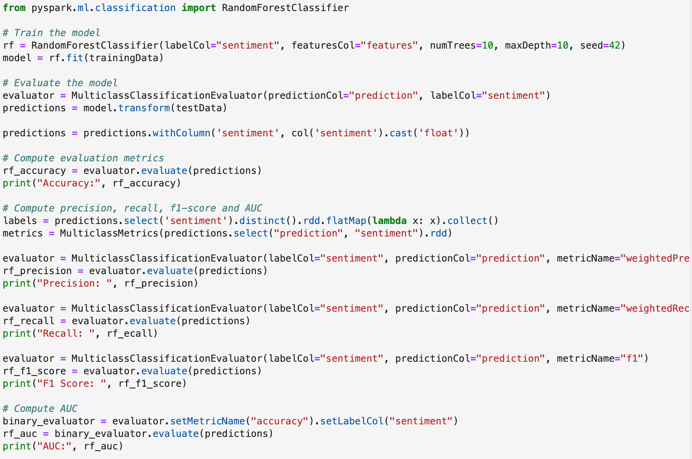
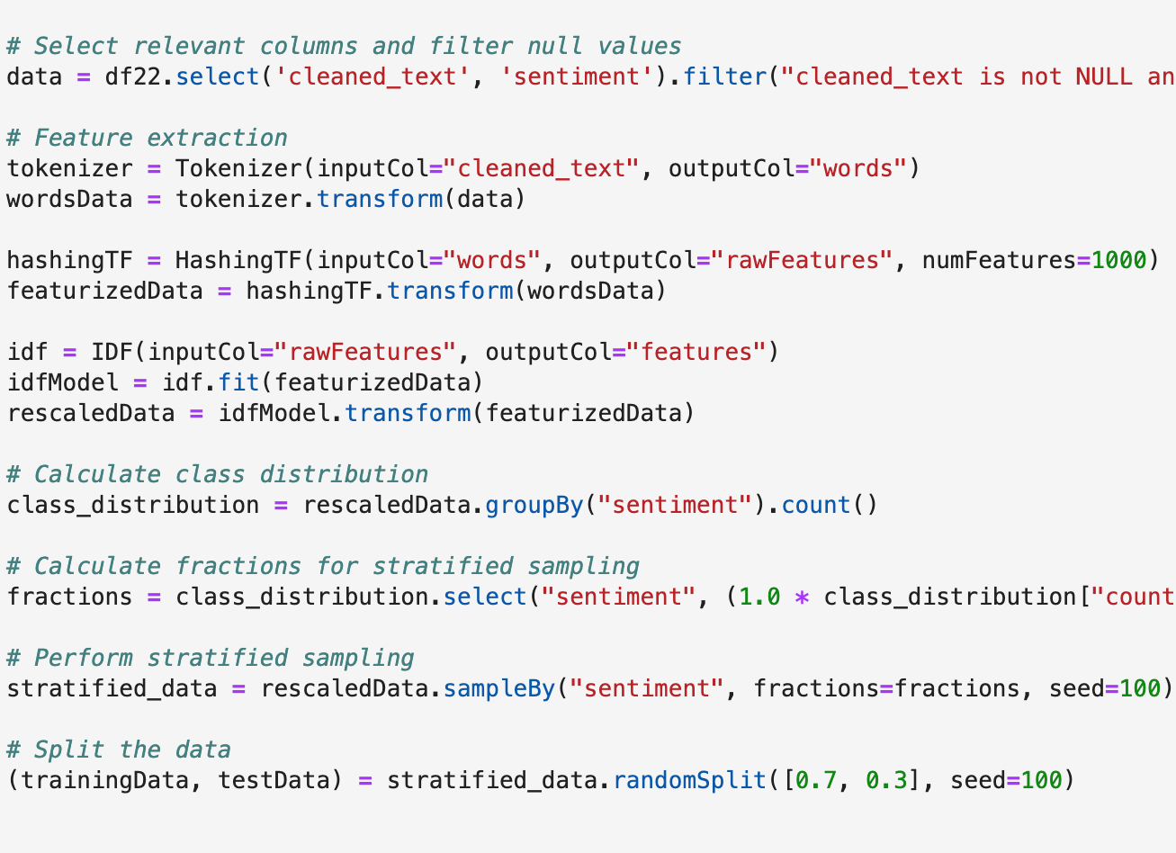
4. Queries: Modelling

Slide 20
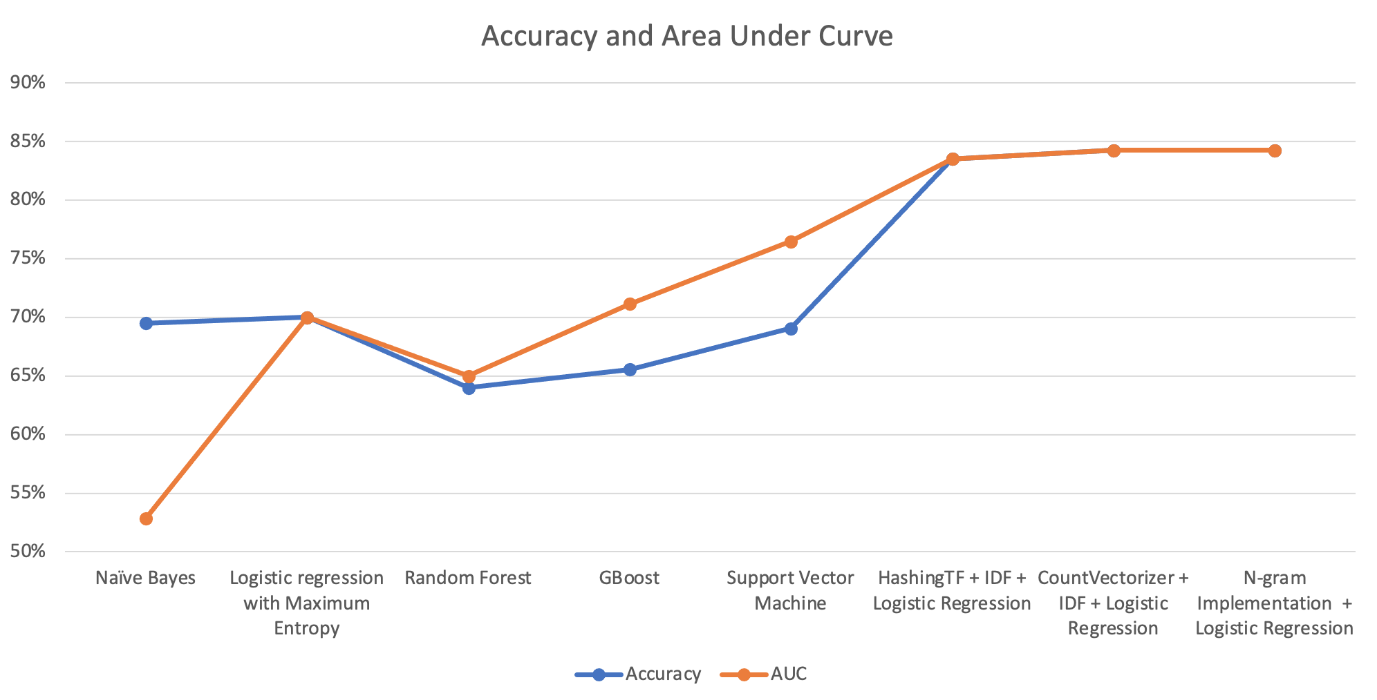
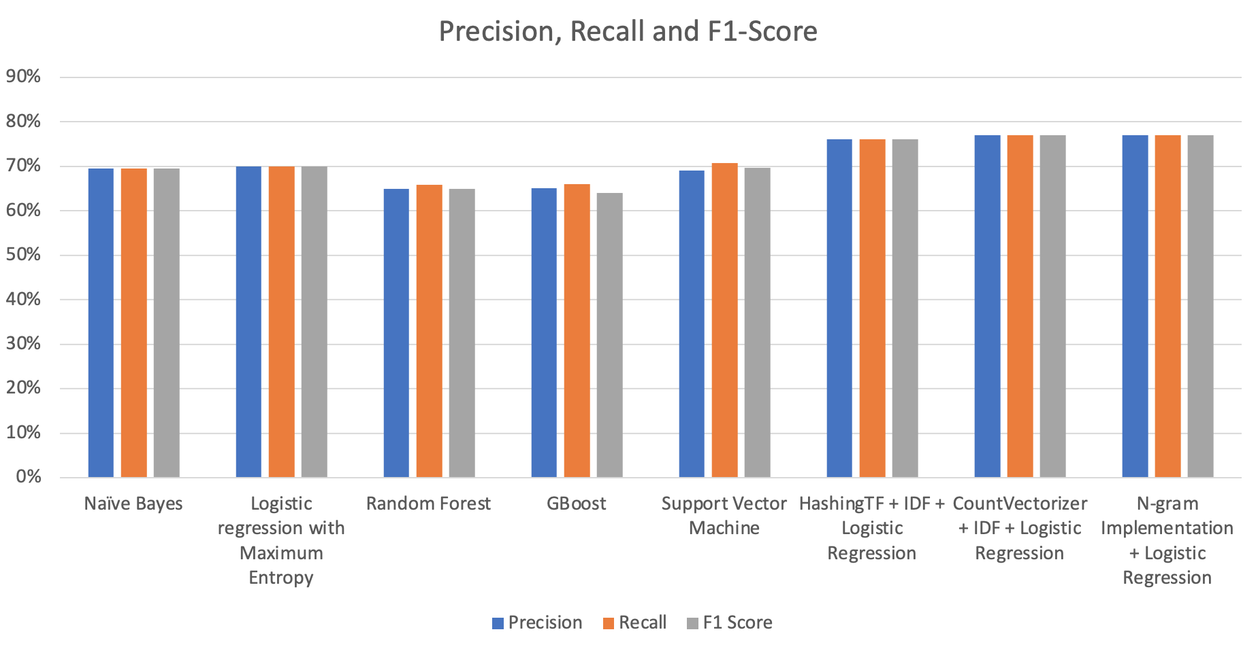
4. Modeling Results
Notes:
Precision, accuracy, recall, area under curve, and F1-score are evaluation metrics commonly used in machine learning classification tasks.
Precision: measures the percentage of true positive predictions among all positive predictions. It is defined as the ratio of true positive (TP) to the sum of true positive and false positive (FP) predictions. High precision means that the classifier has a low false positive rate.
Accuracy: measures the percentage of correct predictions among all predictions. It is defined as the ratio of true positive and true negative (TN) to the sum of true positive, true negative, false positive, and false negative (FN) predictions. High accuracy means that the classifier has a low overall error rate.
Recall: measures the percentage of true positive predictions among all actual positive instances. It is defined as the ratio of true positive to the sum of true positive and false negative (FN) predictions. High recall means that the classifier has a low false negative rate.
Area Under the Curve (AUC): represents the area under the Receiver Operating Characteristic (ROC) curve, which is a plot of true positive rate (sensitivity) against false positive rate (1-specificity) at different classification thresholds. AUC measures the overall performance of a classifier, where higher values indicate better performance.
F1-score: is the harmonic mean of precision and recall, which balances the trade-off between precision and recall. It is defined as 2 * (precision * recall) / (precision + recall). A high F1-score means that the classifier has both high precision and recall.

Slide 21
4. Best Model
86,2%
76,4%
CountVectorizer + IDF + Logistic Regression
Low CPU time and wall time compared to others
Accuracy
86%
Area Under Curve
Precision
76,3%
Recall & F1-Score

Slide 22
5. Benefits of Dataproc for Big Data
High Performance
Advanced Features
DataProc clusters can be configured with powerful hardware resources, allowing for high-performance big data processing. The distributed nature of DataProc clusters enables parallel processing, which can significantly speed up data processing tasks.
DataProc offers advanced features like auto-scaling and custom machine types. Auto-scaling allows the cluster to automatically adjust its size based on workload demands, custom machine types enable to tailor the cluster's resources to a specific requirements.

Slide 23
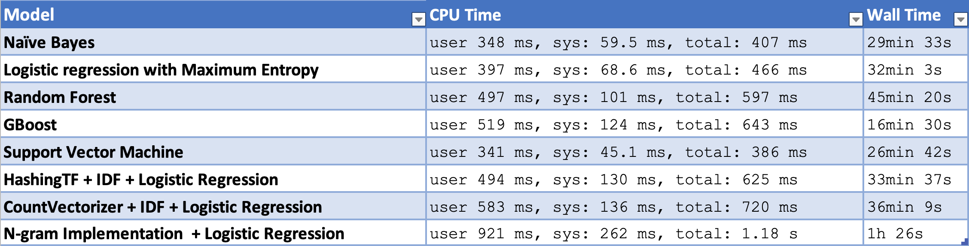
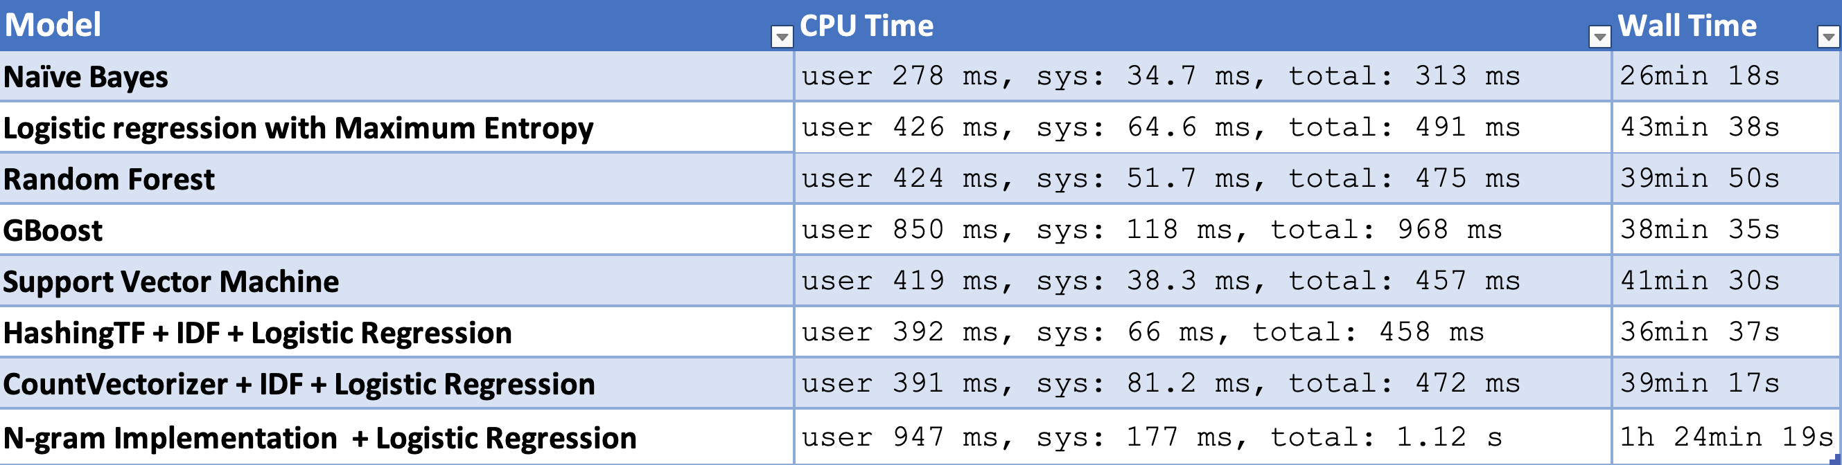
5. Runtime performance
N1 with 3 worker nodes
N2 with 2 worker nodes

Slide 24
6. Results
Cluster 1 :
Cluster 2:
Cluster Size: Machine Type : n1 standard 4 Master Node : 1
Memory: 15GB CPU: 4 CPU Primary Disc Size: 100 GB Performance Metrics: Stratified Sampling: 10 min 32s Modelling: 4 h 36 min Performance: The N1 Standard 4 has more vCPUs and memory, which typically translates to better performance for CPU and memory-intensive tasks. The workload required higher compute power/memory capacity,so N1 Standard 4 is better.
Cost: The N2 Standard 2 has fewer resources compared to the N1 Standard 4, which means that it is more cost-effective choice.
Cluster Size: Machine Type : n2 standard 2 Master Node : 1
Memory: 8GB CPU: 2 CPU Primary Disc Size: 500 GB Performance Metrics: Stratified Sampling : 8min 46s Modelling: 5 hr 48 min

Slide 25
Challenges and Future Work
Modelling
DataProc
Unfortunatlly Spark doesn’t support the implementation of several models incluiding CNN and RNN. This two models often require significant amounts of memory. Besides that, while Spark supports parallelism at a higher level, it may not fully exploit the parallelism potential of deep learning models.
Due to the limitation of our resources with google cloud we could only run the code for N2(Machine Type) with 1 master and 2 workers nodes. When trying to define a new cluster for N2 with different configuration it didn’t allow. We could only run with 3 working nodes for N1.

Slide 26

Thank YOU! Question Time!
Credits : Karim Kousa | Silvia Tavares| Juliana Machado Matheus Utino |Mohammed Rasa

